Slide 1
GEB ONLINE
A Website Project To Make Things Easy.

Slide 2
A Project By
Raj Patel - 206370307012
Nihar Mistry - 206370307002

Slide 3
Definition
In our project of web development, we want to make a webpage of a Gujarat Electrical Board which provides a faster and easier access to other several accessibilities like replacing meter, paying bills, altering the user information, application for new connection etc..

Slide 4
ABSTRACT
As in our day to day life we are having a busy schedule and in that busy schedule we don’t get time standing in lines and wasting our time.
There are the websites for electricity and all, but it only provide the payment options for bill and it also sometimes get complicated.

Slide 5
ABSTRACT (Cont…)
So for the solution of this, we would like to develop a electrical board website which has all the features that can we easily accessed just after logging in.
In our website, firstly there would be login page and if the user is not registered then a user registration option will be there where the user can register himself and can access easily all the features.

Slide 6
Some of the features are…
New Connection
Increasing The Load
Transferring The Connection
Generation Of Bill
Payment Of Bill
Query And Solution

Slide 7
Software interface
Front End
PHP
PHP is a server side scripting language. That is used to develop Static websites or Dynamic websites or Web applications. PHP stands for Hypertext Pre-processor, that earlier stood for Personal Home Pages. PHP scripts can only be interpreted on a server that has PHP installed.

Slide 8
Software interface
Back End
My SQL
MySQL is a relational database management system based on the Structured Query Language, which is the popular language for accessing and managing the records in the database.

Slide 9
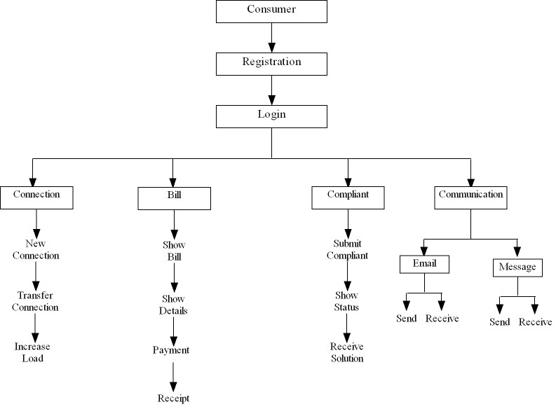
Flowchart of consumer side

Slide 10
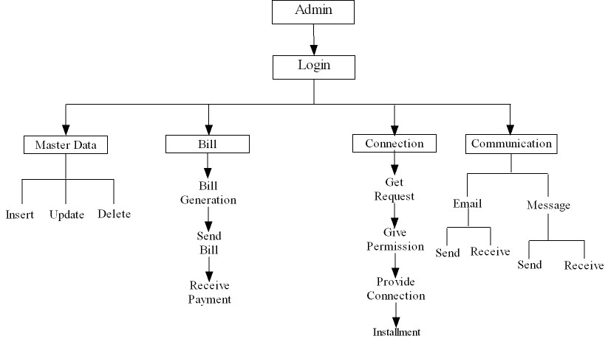
Flowchart of admin side

Slide 11
TABLE SPECIFICATION
REGISTER_DETAILS
SR_NO | COLUMN NAME | DATATYPE(SIZE) | CONSTRAINT
1 | Regid | Int(5) | Primary key
2 | Regdate | Date | Not Null
3 | Username | Varchar(20) | Unique
4 | Password | Varchar(10) | Not Null
5 | Usertype | Varchar(15) | Not Null
6 | Emailid | Varchar(50) | Not Null

Slide 12
TABLE SPECIFICATION
CONTACT_DETAILS
SR_NO | COLUMN NAME | DATATYPE(SIZE) | CONSTRAINT
1 | Contactid | Int(3) | Primary key
2 | Contactdate | Date | Not Null
3 | Personname | Varchar(20) | Not Null
4 | Conatactno | Varchar(15) | Not Null
5 | Emailid | Varchar(50) | Not Null
6 | Description | Varchar(50) | Not Null

Slide 13
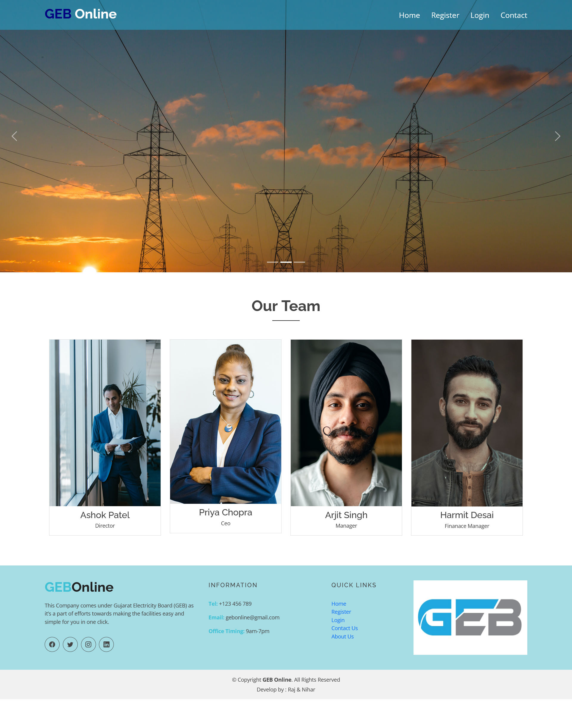
snapshots
Home Page

Slide 14
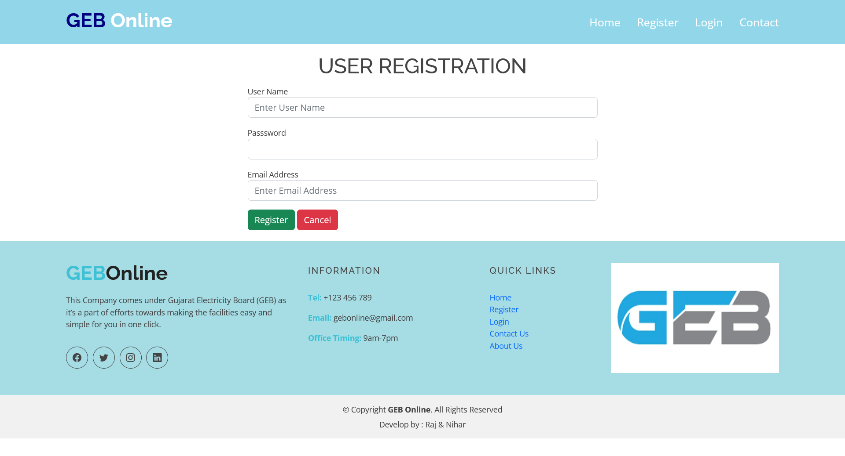
snapshots
Registration Page

Slide 15
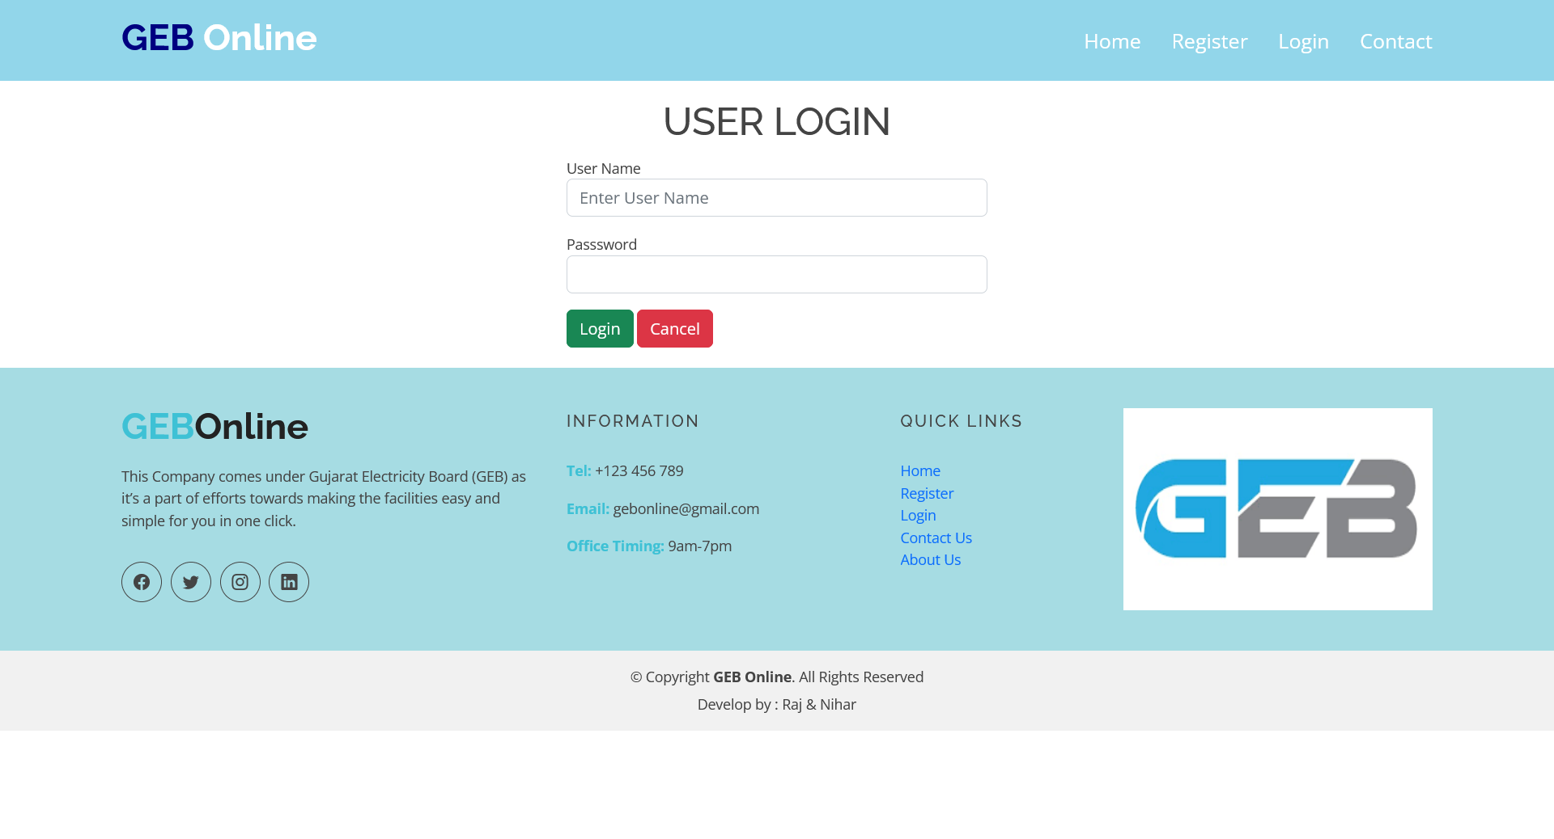
snapshots
User Login

Slide 16
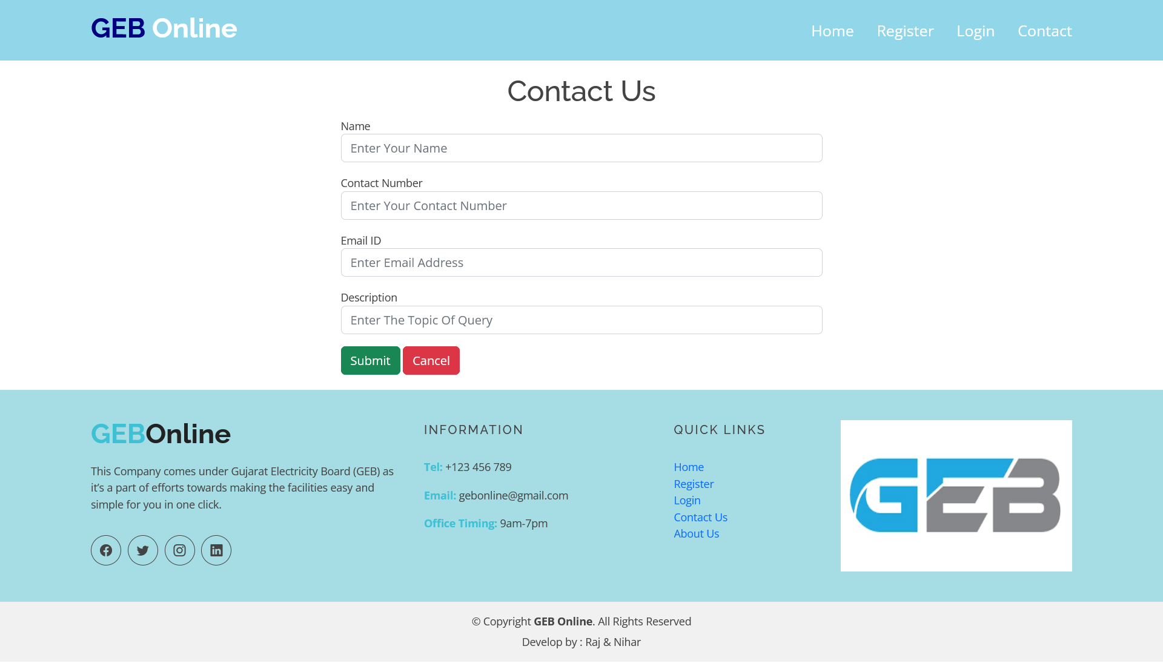
snapshots
Contact Us

Slide 17
Advantages
Provides much better services in online.
Online Payment can be done.
Details of customer will be saved in Database.
All the details are in Digital format.
Data will be Safe and Secure.
As well as User has an option for “Contact us” where user can declare the problems and further solutions will be given.

Slide 18
Disadvantages
Computer/Laptop is required.
Requires reliable internet connection.

Slide 19
FUTURE SCOPE
The project GEB ONLINE System is very Flexible for consumers as well as for the admin.
The system can be further enhanced and several other functionalities can be added.
This project also has the scope of enhancements like:
Customer can pay their Bill Through Online Transaction .

Slide 20
CONCLUSION
This GEB ONLINE System can provide you much more advantage than earlier physical systems. Our main objective is to provide better performance and time saving for the consumer as well as for admin(Employee) to keep the records in correct and systematic order in database.

Slide 21
THANK YOU…

